Slide 1
Introduction to MongoDB

Slide 2
What is NoSQL?
A NoSQL database provides a mechanism for storage and retrieval of data which is modelled in means other than the tabular relations used in relational databases
Why NOSQL?
It's high performance with high availability, and offers rich query language and easy scalability.

Slide 3
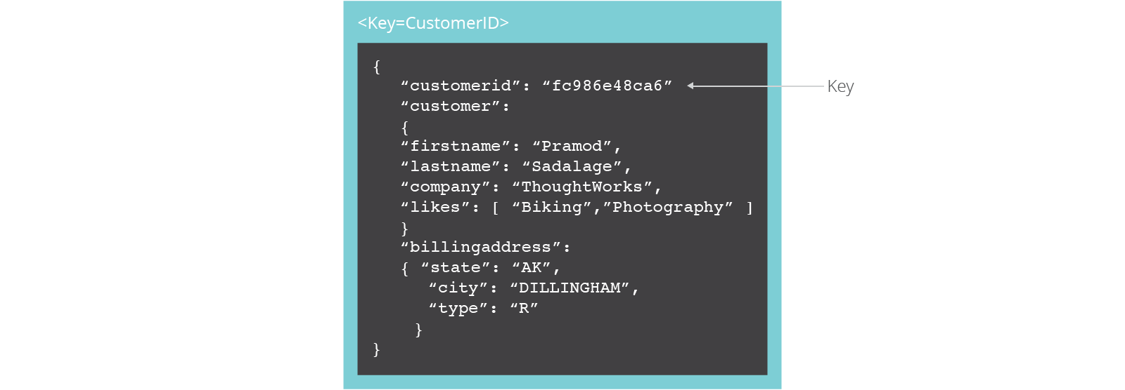
Document Oriented NoSQL DB
Document databases pair each key with a complex data structure known as a document.
Documents can contain many different key-value pairs, or key-array pairs, or even nested documents.

Slide 4








NoSQL examples
Key-value
Graph database
Document-oriented
Column family
4
Notes:
Huge quantity of data => Distributed systems => expensive joins =>
New fields, new demands (graphs) =>
Different data strucutres:
Simplier or more specific

Slide 5
BENEFITS OF NOSQL
When compared to relational databases, NoSQL databases are more scalable and provide superior performance, and their data model addresses several issues that the relational model is not designed to address:
Large volumes of rapidly changing structured, semi-structured, and unstructured data
Agile sprints, quick schema iteration, and frequent code pushes
Object-oriented programming that is easy to use and flexible
Geographically distributed scale-out architecture instead of expensive, monolithic architecture
Dynamic Schema
Auto Sharding
Replication

Slide 6
What is MongoDB?
MongoDB is:
Cross-platform.
Open source.
Non-relational.
Distributed.
NoSQL.
Document-oriented data store.

Slide 7
Why MongoDB?
Open Source
Distributed
Fast In-Place Updates
Replication
Full Index Support
Rich Query Language
Easy Scalability
Auto Sharding

Slide 8















In Production
8
http://www.mongodb.org/about/production-deployments/
Notes:
2009: Initial release
At now: version 2.2.3
8

Slide 9
Basics of MongoDB

Slide 10
JSON (Java Script Object Notation)
Example with CSV and XML: Drawbacks
Sample JSON Document
{
FirstName: John, LastName: Mathews,
ContactNo: [+123 4567 8900, +123 4444 5555]
}
Big Data and Analytics by Seema Acharya and Subhashini Chellappan
Copyright 2015, WILEY INDIA PVT. LTD.

Slide 11
JSON - BSON
Mongo DB actually does not use JSON but BSON (Binary JSON)
It is used to store complex data structures.
JSON is very expressive. It provides the much needed ease to store and retrieve documents in their real form.
The binary form of JSON is BSON. It consumes very less space compared to JSON.
BSON can be easily convert into programming language's native data format.
There are Mongo DB drivers available for a number of programming languages such as C, C++, Ruby, PHP, Python, C# etc.

Slide 12
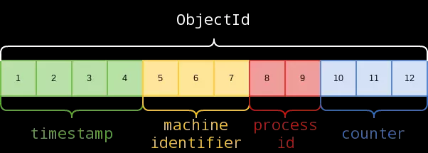
Unique Identifier
Each JSON document should have a unique identifier. It is the _id key.
It is similar to primary key in RDBMS.

Slide 13
Unique Identifier
Benefits
ObjectID is automatically generated by the database drivers, and will be assigned to the _id field of each document.
ObjectID can be considered globally unique for all practical purposes.
ObjectID encodes the timestamp of its creation time, which may be used for queries or to sort by creation time.
ObjectID is mostly monotonically increasing.

Slide 14
Basic data units
Data base
It is a collection of collections. It is like container for collection.
Collection:
A collection is a analogous to a table of RDBMS.
Collection is created on demand.
A collection exists within a single DB.
A collection holds several Mongo DB documents.
The documents within the collection have same fields, the order of fields can be different.
Document
A document is a analogous to row/tuple/record in an RDBMS table

Slide 15
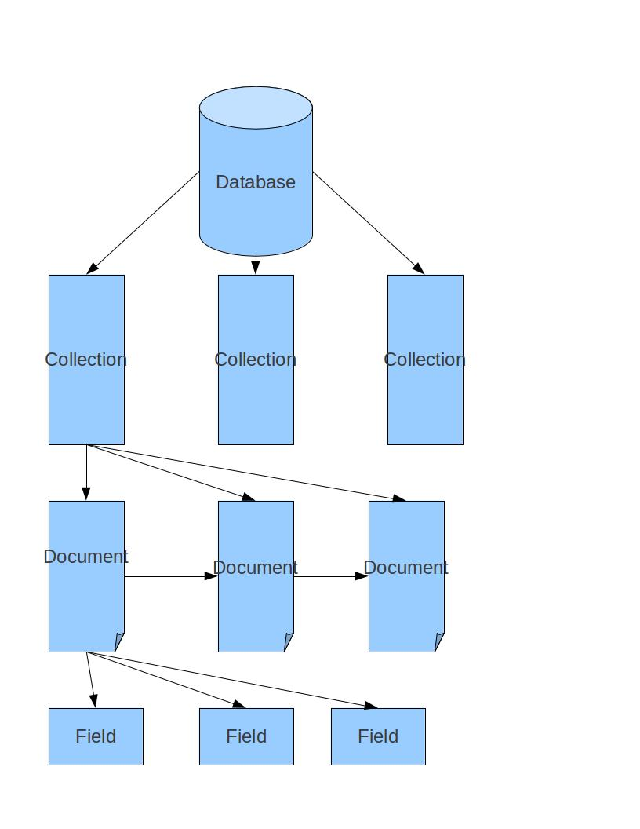
Basic data units

Slide 16
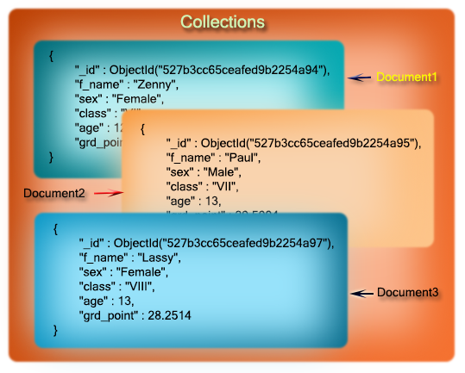
Basic data units

Slide 17
Key Features of MongoDB

Slide 18
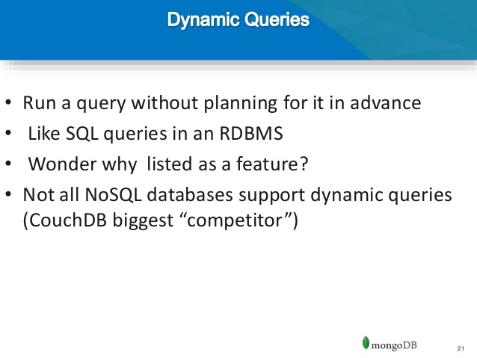
Support for Dynamic Queries
MongoDB has extensive support for dynamic queries.
This is in keeping with traditional RDBMS wherein we have static data and dynamic queries.
Big Data and Analytics by Seema Acharya and Subhashini Chellappan
Copyright 2015, WILEY INDIA PVT. LTD.

Slide 19
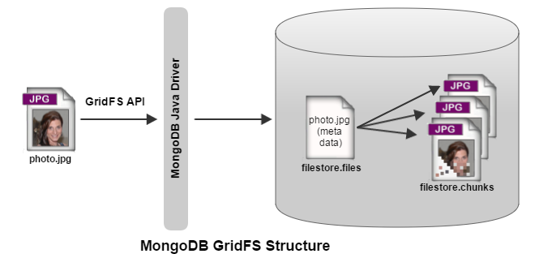
Storing Binary Data
MongoDB provides GridFS to support the storage of binary data.
Instead of storing a file in a single document, GridFS divides the file into parts, or chunks ,and stores each chunk as a separate document. By default, GridFS uses a chunk size of 255 kB
It can store up to 4 MB/16MB of data.( this is sufficient for photographs)
To store movie clips we can use Mongo DB.
It stores meta data in a collection called “file”.

Slide 20





Replication in MongoDB
Client Application
Writes
Reads
Primary
Replication
Replication
Replication
Secondary
Secondary
Secondary

Slide 21
Replication
Replication is the process of synchronizing data across multiple servers.
Replication provides redundancy and increases data availability with multiple copies of data on different database servers.
Replication protects a database from the loss of a single server.
Replication also allows you to recover from hardware failure and service interruptions.

Slide 22
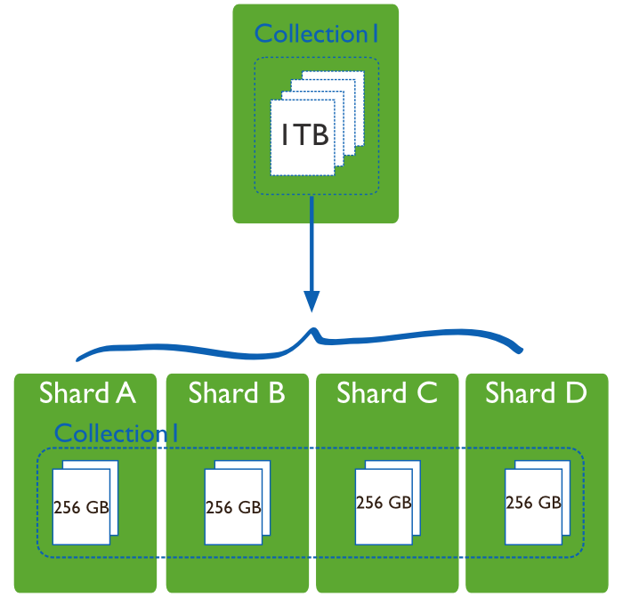
Sharding in MongoDB
Sharding is the process of storing data records across multiple machines.
As the size of the data increases, a single machine may not be sufficient to store the data nor provide an acceptable read and write throughput.
Sharding solves the problem with horizontal scaling.

Slide 23
Updating Information In-Place
Mongo DB updates information in-place , it means that it updates the data wherever it is available.
Mongo DB is all for lazy- writes.
It writes to the disk every second. (it is slow compared to memory)
But Mongo DB is faster than its other competitors.

Slide 24
Terms Used in RDBMS and MongoDB
SQL Terms |  | MongoDB Terms
database |  | database
table |  | collection
row |  | document or BSON document
column |  | field
index |  | index
table joins |  | embedded documents and linking
primary key Specify any unique column or column combination as primary key. |  | primary key In MongoDB, the primary key is automatically set to the _id field.

Slide 25
Executables Comparison
 | MongoDB | MySQL | Oracle | Informix | DB2
Database Server | mongod | mysqld | oracle | IDS | DB2 Server
Database Client | mongo | mysql | sqlplus | DB-Access | DB2 Client

Slide 26
SQL Concepts Vs MongoDB Aggregation
SQL Concepts |  | MongoDB Aggregation Operators
WHERE |  | $match
GROUP BY |  | $group
HAVING |  | $match
SELECT |  | $project
ORDER BY |  | $sort
LIMIT |  | $limit
SUM() |  | $sum
COUNT() |  | $sum
join |  | $lookup

Slide 27
MongoDB Query language

Slide 28
Data types
Type | Number |  | Type | Number
Double | 1 |  | Null | 10
String | 2 |  | Regular Expression | 11
Object | 3 |  | DBPointer | 12
Array | 4 |  | JavaScript | 13
Binary data | 5 |  | Symbol | 14
Undefined | 6 |  | int | 16
ObjectId | 7 |  | timestamp | 17
Boolean | 8 |  | long | 18

Slide 29
CRUD operations
CRUD( Create, Read, Update and Delete) operations in Mongo DB
Create: Creation of data done using Insert() /Update() /Save()
Read: Reading data is performed using find() method
Update: Update data is accomplished using the update() method with UPSERT set to false.
Delete: a document is deleted using the remove() method
The Order of CRUD is ,
Data base
Collections
Documents

Slide 30
Data base
To create data base
use Data base name;
use studentdb;
To display the list of data bases
show dbs;
To display the current data base
db;
To switch to new data base
use data base name;
To display the list of collections (tables) in the current DB
show collections;

Slide 31
Data base
To drop the data base:
db.dropDatabase()
Other commands:
db.version()
db.status()
db.help()

Slide 32
Collections
To create a collection by the name “Person”. Let us take a look at the collection list prior to the creation of the new collection “Person”.
db.createCollection(“Person”);
Big Data and Analytics by Seema Acharya and Subhashini Chellappan
Copyright 2015, WILEY INDIA PVT. LTD.

Slide 33
Collections
To drop a collection by the name “food”.
db. Collection name.drop()
db.food.drop();
Big Data and Analytics by Seema Acharya and Subhashini Chellappan
Copyright 2015, WILEY INDIA PVT. LTD.

Slide 34
Document - Insert Method
Create a collection by the name “Students” and store the following data in it.
The fields are
Stud Name
Grade
Hobbies
db.createCollection(“Students”);
db.Students.insert({_id:1, StudName:"Michelle Jacintha", Grade: "VII", Hobbies:"Internet Surfing"});
Big Data and Analytics by Seema Acharya and Subhashini Chellappan
Copyright 2015, WILEY INDIA PVT. LTD.

Slide 35
To check the document is created or not?
db. Collection name.find();
db.Students.find();
> { _id:1, “StudName”:"Michelle Jacintha", “Grade”: "VII", “Hobbies” :"Internet Surfing"});

Slide 36
To format the result
db. Collection name.find().pretty();
db.Students.find().pretty();
> {
_id:1,
StudName:"Michelle Jacintha",
Grade: "VII",
Hobbies:"Internet Surfing“
}

Slide 37
Automatic id generation
db.collectionname.insert( { }) Don’t mention id field
db.students.insert({StudName:"Michelle Jacintha", Grade: "VII", Hobbies:"Internet Surfing"});

Slide 38
Update method
Update method inserts the new document when the document is not exists
If the document is already exists , then updates with new values.
db.collection.update(query, update, options)
Query: document
Update: modifications need to apply
options:
Upsert:
If set to true, creates a new document when no document matches the query criteria.
The default value is false, which does not insert a new document when no match is found.
Set: Update option
Multi
If set to true, updates multiple documents that meet the query criteria.

Slide 39
Update Method
Insert the document for “Aryan David” into the Students collection only if it does not already exist in the collection.
However, if it is already present in the collection, then update the document with new values. (Update his Hobbies from “Skating” to “Chess”.)
Use “Update else insert” (if there is an existing document, it will attempt to update it, if there is no existing document then it will insert it).
db.Students.update({_id:2, StudName:"Aryan David", Grade: "VII"},{$set:{Hobbies: "Skating"}},{upsert:true});
Big Data and Analytics by Seema Acharya and Subhashini Chellappan
Copyright 2015, WILEY INDIA PVT. LTD.

Slide 40
Update Method- Adding a new field
Change the student Aryan David hobbies as chess
db.students.update( {_id:2},{$set:{Hobbies:”Chess”} });
Multiple insertions and updates are possible

Slide 41
Find with conditions
db.students. find({_id:1});
db.students.find({Hobbies:"Internet Surfing"});
db.students.find({Hobbies:"Internet Surfing"}).pretty();

Slide 42
Find Method
To search for documents from the “Students” collection based on certain search criteria.
db.Students.find({StudName:"Aryan David"});
Big Data and Analytics by Seema Acharya and Subhashini Chellappan
Copyright 2015, WILEY INDIA PVT. LTD.

Slide 43
Find Method- To suppress the id field
To display only the StudName and Grade from all the documents of the Students collection. The identifier _id should be suppressed and NOT displayed.
db.Students.find({},{StudName:1,Grade:1,_id:0});
From all
Big Data and Analytics by Seema Acharya and Subhashini Chellappan
Copyright 2015, WILEY INDIA PVT. LTD.

Slide 44
Find Method-with Relational operators
To find those documents where the Grade is set to ‘VII’
db.Students.find({Grade:{$eq:'VII'}}).pretty();
db.Students.find({Grade:{$ne:'VII'}}).pretty();
Big Data and Analytics by Seema Acharya and Subhashini Chellappan
Copyright 2015, WILEY INDIA PVT. LTD.

Slide 45
Relational operators
$eq -> equal to
$ne -> not equal
$gte -> greater than or equal to
$lte -> less than or equal to
$gt -> greater than
$lt -> less than
$in -> either or
$nin ->neither nor

Slide 46
String operations
String Begins with some character: /^ char/
Eg:
db.Students.find ( { studName :/^A/}).pretty();
String End with some character: /char $/
Eg:
db.Students.find({ studName:/s$/}).pretty();
Char in any position: /char/ OR /.*char.*/ OR $regex:”char”
Eg:
db.Students.finf({studName:/e/}).pretty();

Slide 47
Dealing with NULL values
A null is a missing or unknown value.
Eg:
db.Students.update({-id:3},{$set:{location:null}});
To remove NULL values
Eg:
db.Students.update({-id:3},{$unset:{location:null}});

Slide 48
Count
To find the number of documents in the Students collection.
db.Students.count();
db.Students.count({grade:”VII”});
db.Students.count({grade:”VII”}). limit(3). Pretty();
Big Data and Analytics by Seema Acharya and Subhashini Chellappan
Copyright 2015, WILEY INDIA PVT. LTD.

Slide 49
Sort
To sort the documents from the Students collection in the descending order of StudName.
db.Students.find().sort({StudName:-1}).pretty();
In Ascending order:
db.Students.find().sort({StudName:1}).pretty();
EG:
db.Students.find().sort({grade: 1 ,StudName:-1}).pretty();
Big Data and Analytics by Seema Acharya and Subhashini Chellappan
Copyright 2015, WILEY INDIA PVT. LTD.

Slide 50
Skip
db.Students.count({grade:”VII”}). skip(2). Pretty();
db.Students.find().skip(1).pretty();

Slide 51
To display last few records
To display last two records
db.Students.find().pretty().skip(db.Students.count()-2);
To display 3rd, 4th and 5th records
db.Students.find().skip(2).limit(3)

Slide 52
ARRAY

Slide 53
Array creation
To create a collection by the name “food”.
Insert the documents in to collection , each document should have a “fruits "array.
db.createCollection(“food”);
db. food.insert({_id:1,fruits:[ ‘banana’, ’apple’, ’cherry’ ]});
db. food.insert({_id:2,fruits:[ ‘orange’, ’mango’, ’butter fruit’ ]});
db. food.insert({_id:3,fruits:[ ‘pineapple’, ’apple’, ’grapes’ ]});
db. food.insert({_id:4,fruits:[ ‘pineapple’, ’apple’, ’grapes’ ]});
db. food.insert({_id:5,fruits:[ ‘strawberry’, ’grapes’ ]});

Slide 54
Array operations
db.food.find({});
db.food.find( {fruits: [‘banana’, ’apple’, ’cherry’ ] } ).pretty();
To find documents which have grapes in first index position
db.food.find( {‘fruits.1 ‘ : ‘grapes’} )
To find documents from the food collection where the size of array is two.
db.food.find( {“fruits” : {$size:2}})

Slide 55
Array operations
To display first two elements from the array
db.food.find( {_id:1}, {“fruits”:{$slice:2} })
db.food.find( {_id:1}, {“fruits”:{$slice:[0,2] } })
db.food.find( { fruits: ( $all: [“orange”, “grapes” ]}}).pretty();

Slide 56
Update in array
To replace the first index position in document 4
db.food.update ({_id:4},{ $set:{‘fruits.1’: ’apple’}});
To push new key value pairs in the fruits array.
db. food. update ( {_id:2}, ($push: {price: {orange:60,butterfruit:200,mango:120} }})

Slide 57
Update in array
Adding an element into the array list
db.food. Update( { _id:4}, { $addToSet :{fruits: “ orange”}} );
Popping an element from the end of the list.
db.food. Update ( {_id:4}, {$pop: {fruits:1}} );
Popping an element from the beginning of the list.
db.food. Update ( {_id:4}, {$pop: {fruits:-1}} );

Slide 58
Update in array
The $pull operator removes all elements in the array that match a specified value.
The $pullAll operator removes all elements in the array that match any of the specified values.

Slide 59
Aggregate Function

Slide 60
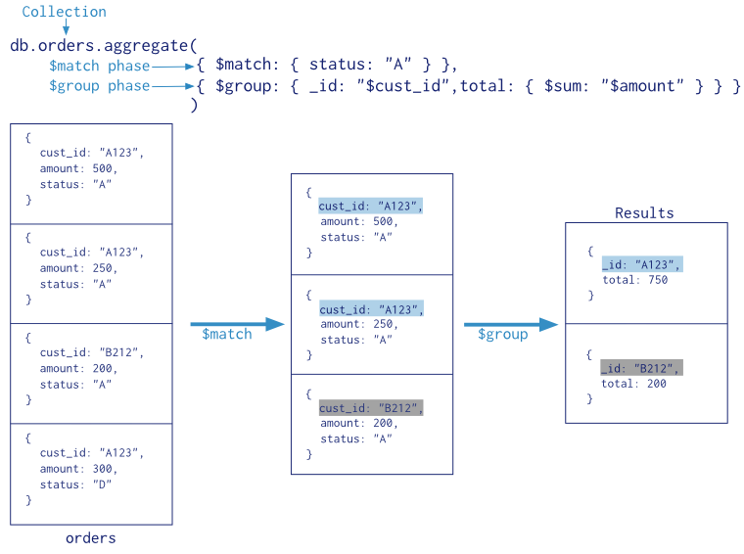

Slide 61
Aggregate Function
First filter on “AccType:S” and then group it on “CustID” and then compute the sum of “AccBal” and then filter those documents wherein the “TotAccBal” is greater than 1200, use the below syntax:
db.Customers.aggregate( { $match : {AccType : "S" } },
{ $group : { _id : "$CustID",TotAccBal : { $sum : "$AccBal" } } },
{ $match : {TotAccBal : { $gt : 1200 } }});
Big Data and Analytics by Seema Acharya and Subhashini Chellappan
Copyright 2015, WILEY INDIA PVT. LTD.

Slide 62
MapReduce Framework

Slide 63
MapReduce Framework
{ } | CustID: “C123”, AccBal: 500, AccType: “S”
{ } | CustID: “C123”, AccBal: 900, AccType: “S”
{
 | CustID: “C111”,
query
 | AccBal: 1200,
 | AccType: “S”
}
{ } | CustID: “C123”, AccBal: 1500, AccType: “C”
{ } | CustID: “C123”, AccBal: 500, AccType: “S”
{
 | CustID: “C123”,
 | AccBal: 900,
 | AccType: “S”
map
}
{ } | CustID: “C111”, AccBal: 1200, AccType: “S”
{
_id: “C123”,
value: 1400
{“C123”:[ 500,900 ]}
}
{“C111”: 1200 }
{
_id: “C111”,
value: 1200
}
Customer_Totals
Customers
Big Data and Analytics by Seema Acharya and Subhashini Chellappan
Copyright 2015, WILEY INDIA PVT. LTD.

Slide 64
MapReduce
db. Customers.mapReduce (
map -> function() { emit(this.CustID, this.AccBal); },
reduce -> function(key, value) { return Array.sum(values) },
query -> query: { AccType: “S”},
output -> out: “Customer_Totals”
}
)
Map function:
var map =function()
{ emit( this.CustID, this.AccBal) ; }
Reduce Function
var reduce =function(key, values)
{
Return Array.sum(values);}

Slide 65
MapReduce
To execute the query
db.Customers.mapReduce(map,reduce,{ out: “Customer_Totals”, query:{ AccType: “S”}});
db.Customer_Totals.find().

Slide 66
Java Script in MongoDB

Slide 67
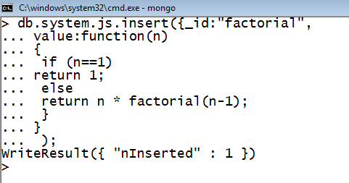

Java Script Programming
To compute the factorial of a given positive number. The user is required to create a function by the name “factorial” and insert it into the “system.js” collection.
Big Data and Analytics by Seema Acharya and Subhashini Chellappan
Copyright 2015, WILEY INDIA PVT. LTD.

Slide 68
Cursors
In the mongo shell, the primary method for the read operation is the db.collection.find() method.
This method queries a collection and returns a cursor to the returning documents.
To access the documents, you need to iterate the cursor.
However, in the mongo shell, if the returned cursor is not assigned to a variable using the var keyword, then the cursor is automatically iterated up to 20 times to print up to the first 20 documents in the results.

Slide 69
Example- cursor
Collection : alphabets
Each document: one alphabet (a, b ,c …z)
db.alphabets.find();
var mycursor= db.alphabets.find();
mycursor;
Two methods:
hasNext(): returns Boolean value
next(): returns next document in the cursor.

Slide 70
Cursor Methods
Name | Description
cursor.explain() | Reports on the query execution plan for a cursor.
cursor.forEach() | Applies a JavaScript function for every document in a cursor.
cursor.hasNext() | Returns true if the cursor has documents and can be iterated.
cursor.hint() | Forces MongoDB to use a specific index for a query.

Slide 71
Indexes
Indexes allow MongoDB to process and fulfil queries quickly by creating small and efficient representations of the documents in a collection.
Users can create indexes for any collection on any field in a document.
By default, MongoDB creates an index on the _id field of every collection.
db.records.createIndex( { userid: 1 } )
db.records.find( { userid: 2 } )
db.records.find( { userid: { $gt: 10 } } )

Slide 72
The ensureIndex() Method
db.COLLECTION_NAME.ensureIndex({KEY:1})
db.mycol.ensureIndex({"title":1})
db.mycol.status();
Get the list of all indexes
db.mycol.getIndexes();
Using hint()
db.people.find( { name: "John Doe", zipcode: { $gt: "63000" } } ).hint( { zipcode: 1 } ).explain("executionStats")

Slide 73
MongoDB Import and Export

Slide 74
Import data from a CSV file
Given a CSV file “sample.txt” in the D: drive, import the file into the MongoDB
collection, “SampleJSON”. The collection is in the database “test”.
Mongoimport --db test --collection SampleJSON --type csv --headerline --file d:\sample.txt
Big Data and Analytics by Seema Acharya and Subhashini Chellappan
Copyright 2015, WILEY INDIA PVT. LTD.

Slide 75
Export data to a CSV file
This command used at the command prompt exports MongoDB JSON documents from “Customers” collection in the “test” database into a CSV file “Output.txt” in the D: drive.
Mongoexport
d:\output.txt
--db test --collection Customers --csv --fieldFile
d:\fields.txt --out
Big Data and Analytics by Seema Acharya and Subhashini Chellappan
Copyright 2015, WILEY INDIA PVT. LTD.

Slide 76
Automatic generation of unique numbers for the –id field- seq
db.counters.insert( { _id: "userid", seq: 0 } );
Create a getNextSequence function that accepts a name of the sequence. The function uses the findAndModify() method to automically increment the seq value and return this new value:
function getNextSequence(name)
{ var ret = db.counters.findAndModify(
{ query: { _id: name },
update: { $inc: { seq: 1 } },
new: true } );
return ret.seq; }

Slide 77
Automatic generation of unique numbers for the –id field-
3. Use this getNextSequence() function during insert().
db.users.insert(
{ _id: getNextSequence("userid"),
name: "Sarah C." } )
db.users.insert( {
_id: getNextSequence("userid"),
name: "Bob D." } )
4. You can verify the results with find():
db.users.find()

